Slide 1


Random Variables
AC52012: Research Methods
Notes:
In this video, we are going to introduce a very important concept of random variables. And then we are going talk about a probability distribution of random variables. And we're going to focus here on discrete probability distribution, which are probability distributions of so-called discrete random variables.

Slide 2
RANDOM VARIABLES
RANDOM VARIABLE:
Variable whose value depends on outcomes of a random procedure. Single numerical value for each outcome of a procedure
DISCRETE RANDOM VARIABLE
Random variable with a finite or countably infinite number of values
CONTINUOUS RANDOM VARIABLE:
Random variable with an uncountably infinite number of values
Notes:
A random variable can informally be defined as a variable whose value depends on outcomes of a random procedure. So we’re going to have a random procedure (rolling a dice, tossing a coin, betting on a roulette wheel, etc) which can produce a number of outcomes, and random variables are determined simply by assigning a numerical value for each of these possible outcomes.
A discrete random variable is a random variable can take only a finite or countably infinite number of values. A continuous random variable, which we’ll look at in the next video, is a variable that can take an uncountable, infinite number of different values.

Slide 3
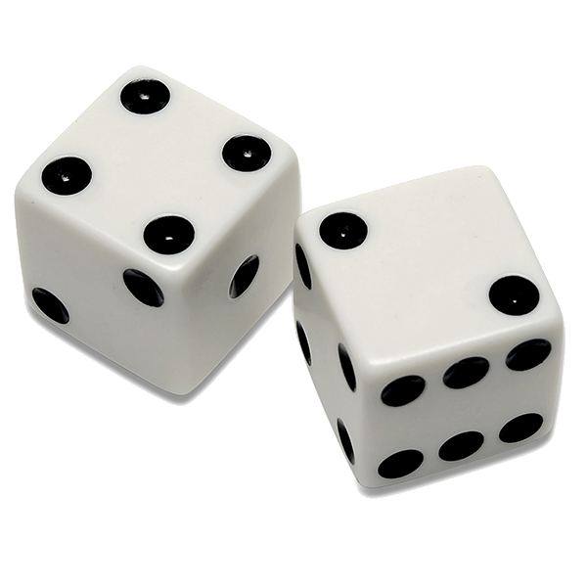
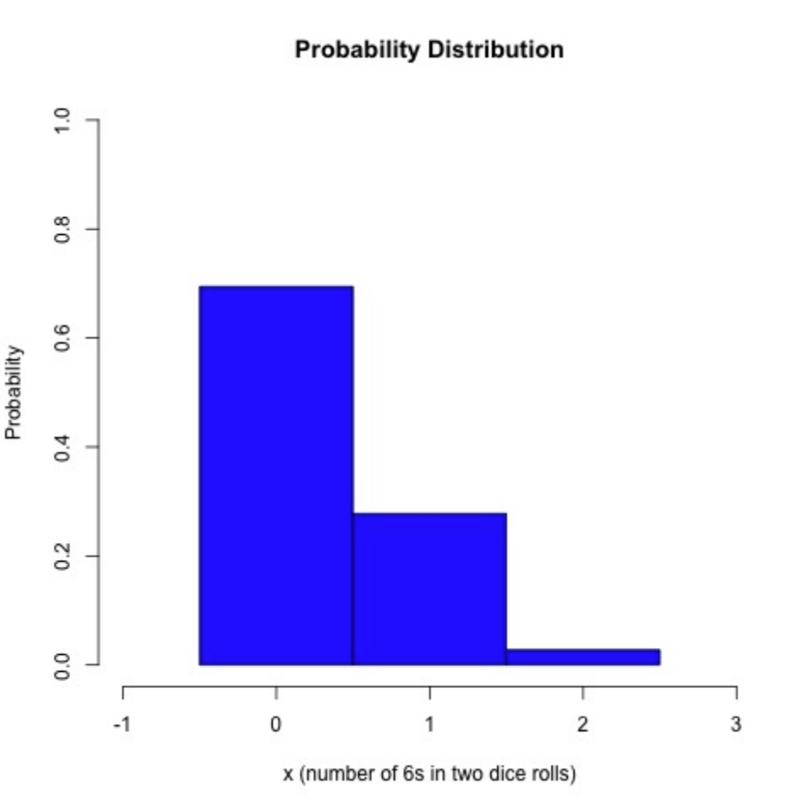


PROBABILITY DISTRIBUTION
Data describing the probability of each value of a random variable.
Corresponds to the values of a numerical variable x
$\sum_{x}{P\left(x\right)=1}$
$0≤P(x)≤1$ for each individual value of x
- roll 6-sided dice 2 times
- x = number of 6s we get
- classical probability
Possible x = {0,1,2}
{11, 12, 13, 14, 15, 16,
21, 22, 23, 24, 25, 26,
31, 32, 33, 34, 35, 36,
41, 42, 43, 44, 45, 46,
51, 52, 53, 54, 55, 56,
61, 62, 63, 64, 65, 66}
$$P\left(x=0\right)=\frac{25}{36}$$
$$P\left(x=1\right)=\frac{10}{36}$$
$$P\left(x=2\right)=\frac{1}{36}$$
Notes:
And related to random variables is a probability distribution. A probability distribution is a function that gives the probability for each different value that the random variable can take. There are three requirements that a probability distribution must satisfy. First, it needs to correspond to the values of a numerical random variable x. The sum of the probabilities that random variable can take has be one. And the probability of each individual value that a random variable can take has to be between 0 and 1. If our probability function satisfies all three of these conditions, then we can call it a probability distribution of numerical random variable X.
Now to make these concepts a bit more concrete, let’s have an example. Suppose that we are rolling a six-sided dice two times. This gives us a sample space of 36 different events. And let's say that our random variable X is the number of 6s that we get in these two rolls. So in this case, we have a random variable X and we assign to each simple event a number, which is the number of sixes. Assuming that our dice is homogeneous, meaning that we are equally likely to get each number in each roll, we’ll find the probability distribution for random variable x – which can take three different values: 0 – neither dice shows a 6; 1 – only one of our dice shows a 6; or 2 – both dice are 6s. Therefore, this is a discrete random variable – it’s finite and countable. So in order to find a probability distribution of variable x, we need to see what the probability is of getting each of these three different values for our random variable.
Looking at the sample space of rolling two dice, there are 36 possibilities. 25 of these involve no 6s at all, 10 of these involve a single 6, and only one has the double 6. And so we have the probability of each of our possible values of X by dividing these numbers by the whole sample space (i.e., 36). So we can see that a function p defined this way is indeed a probability distribution because each of these values is between 0 and 1. Each gives us the probability of getting exactly our variable x given some value, and they sum to 36/36, which is one! We can visually represent this distribution using a histogram. This is produced by using R.

Slide 4



PARAMETERS OF PROBABILITY DISTRIBUTION
Probability distribution describes the population rather than a sample!
parameters of the population, wrt random variable x.
MEAN – or MATHEMATICAL EXPECTATION
$$μ (or E)=\sum_{x}{[x⋅P\left(x\right)]}$$
VARIANCE
$$σ^{2}=\sum_{x}{\left[x^{2}⋅P\left(x\right)\right]−μ^{2}}$$
STANDARD DEVIATION
$$σ=\sqrt{\sum_{x}{\left[x^{2}⋅P\left(x\right)\right]−μ^{2}}}$$
Notes:
So an important thing to note is that, if we have a random variable, then it is defined over the whole population rather than a sample – that is, random variables characterise the whole population. Hence the probability distribution also describes the whole population rather than a sample. This probability distribution can be summarised, or described, using parameters, similar parameters that we used for describing the whole dataset - mean, variance and standard deviation.
The mean of a random variable can be defined by taking the sum of all the different values that x can take and calculating the sum of the values X can take multiplied by the probability of X actually occurring.
Related to this is also a concept of mathematical expectation. Mathematical expectation of a discrete random variable is denoted by E and defined by the sum of all possible values that a random variable X can take multiplied by its probability of occurring (i.e., the mean). This is the value that we expect to get after infinitely many repetitions of the same trial – the average value that we are going to get over all our trials. Of course, this might not be a value that we can get in practice – we’re never going to roll 0.7 double-sixes, but informally, it’s the mean of the possible values a random variable can take, weighted by the probability of those outcomes.
We’ve also got our variance defined in the same way as it was last week, and our standard deviation which is simply the square root of the variance. Note the use of simples $μ$ and $σ$ as opposed to x̄ and s, because we’re talking about the population, not the sample.

Slide 5



PARAMETERS OF OUR EXAMPLE
{11, 12, 13, 14, 15, 16,
21, 22, 23, 24, 25, 26,
31, 32, 33, 34, 35, 36,
41, 42, 43, 44, 45, 46,
51, 52, 53, 54, 55, 56,
61, 62, 63, 64, 65, 66}
- roll 6-sided dice 2 times
- x = number of 6s we get
- classical probability
$$P\left(x=0\right)=\frac{25}{36}$$
$$P\left(x=1\right)=\frac{10}{36}$$
$$P\left(x=2\right)=\frac{1}{36}$$
$$μ =\sum_{x}{[x⋅P\left(x\right)]}=0⋅\frac{25}{36}+1⋅\frac{10}{36}+2⋅\frac{1}{36}=\frac{12}{36}=0.33$$
$$σ^{2}=\sum_{x}{\left[x^{2}⋅P\left(x\right)\right]−μ^{2}}=0⋅\frac{25}{36}+1⋅\frac{10}{36}+4⋅\frac{1}{36}−0.19= \frac{14}{36}−0.19=0.39−0.19=0.2$$
$$σ=\sqrt{0.2}=0.45$$
Notes:
Again, let’s see how this looks like in practice with our previous dice example. Suppose we are rolling six-sided dice two times. Our random variable x is the number of 6s that we get. So as we already said, our mean (or expectation) is the sum of each possible value of X multiplied by the probability of its occurrence. So we do this calculation and end up with a mean of approximately 0.33.
Now that we’ve got the mean, we can calculate our variance using the formula on the previous slide. In this case, we take the squares of the values that our random variable can take and multiply them by their probability, and then subtract the square of the mean. This is 0² times the probability of 0, plus 1² times the probability of 1, plus 2² (which is 4) times the probability of 2, minus 0.33² which is roughly 0.19. In doing so, we get a variance of around 0.2. We take the square root of that and get 0.45 for our standard deviation.

Slide 6






USUAL/UNUSUAL VALUES
Let $μ$be the mean and $σ$be the standard deviation of a random variable $x$ on some population
The value of a random variable $x$ is usual if it holds that…
$$μ−2σ≤x≤μ+2σ$$
- roll 6-sided dice 2 times
- x = number of 6s we get
- classical probability
$$P\left(x=0\right)=\frac{25}{36}$$
$$P\left(x=1\right)=\frac{10}{36}$$
$$P\left(x=2\right)=\frac{1}{36}$$
Assuming x is the number of 6s we get, usual values for x are such that:
$$σ=0.45$$
$$μ=0.33$$
$$−0.57≤x≤1.23$$
double 6 is unusual!
Notes:
And similarly to what we had when describing sets of values with Z-scores, we can also use mean and standard deviation of a random variable to determine what we call usual and unusual values that a
random variable x can take. So if $μ$ is the mean of the random variable and $σ$ is standard deviation, the value of random variable x is usual if it’s within two standard deviations of the mean. Otherwise, we call it unusual.
If we're rolling a six-sided dice two times and recording the number of 6s that we get, we can ask the question, what’s an unusual number of 6s? So we know that our mean is 0.33. And our standard deviation is approximately 0.45, and plugging these numbers into our formula, we see that any value which is between -0.57 and 1.23 for the number of 6s is considered usual. Values outside of this
range are considered unusual, and since the only value outside this range that our random variable can take is 2, we can say that a double six is unusual in the context of our experiment. In a way, this formula also says that getting -0.5 sixes is perfectly normal, but that’s not a discrete value of our random variable and so we can ignore that possibility.

Slide 7

BINOMIAL PROBABILITY DISTRIBUTION
A probability distribution resulting from a procedure that meets all the following requirements:
Has a fixed number of trials where a trial is a single observation
Trials are independent
Each trial has outcomes classified into two categories (success or failure)
Probability of a success is the same in all trials.
P(S) = p (probability of a success is p)
P(F) = 1 − p (probability of a failure is 1 − p)
n = number of trials
x =number of successes in n trials
P(x) = probability of getting exactly x successes in n trials
Notes:
So we're going to move on to describing the most commonly-used discrete probability distribution - the binomial probability distribution. Binomial probability distribution results from procedure that meets these four criteria, which are very important to remember. First, the procedure has a fixed number of trials where each trial results in a single observation.
The trials must be independent (the outcome of one does not influence any others).
Each trial must have all outcomes classified into two categories, which we’ll call ‘success’ and ‘failure’.
And the probability of success remains the same in all trials.
So suppose our random variable X is the number of successes in n trials – in this way we we’re assigning a number to each outcome of our procedure. If our procedure satisfies the four criteria, then this random variable will have a binomial probability distribution. This kind of random variable is called a Bernoulli random variable – which is the simplest kind as it can take only two values, 1 or 0, success or failure, etc.
Let’s have a look at the notation we’re going to use for describing these distributions. The probability of success P(S) will be called p. By simple logic, the probability of failure is one minus p because we only have two possible outcomes. N is the number of trials that we have, and X will be the number of successes in n trials, and so P(x)is going to be probability of getting exactly x successes in n trials.
The classic example of this is tossing a fair coin N times. Tossing head (H) can be considered a success and tail (T) a failure, and each toss results in a single outcome. The individual trials are completely independent (getting a T in the fifth toss is completely independent of outcomes of the first four tosses). The probability of success is the same in each trial because the probability of success is always going to be 0.5. This means that all the requirements of for a binomial probability distribution are satisfied. And our random variable x is then the number of heads in n tosses of the coin.
Another more practical example is found in clinical studies. We have n patients and we apply some treatment to each of them. For each patient there are two possible outcomes - either their symptoms improve, or their symptoms don't improve. We can consider each outcome for each patient as a separate trial. Trials are independent - each patient is (or at least should be) independent of all the other patients, and we can assume the probability for each patient improving is the same provided that we apply exactly the same treatment. So again, all the conditions for binomial probability distribution are satisfied.

Slide 8

BINOMIAL PROBABILITY FORMULA
Toss a coin 5 times – what’s the probability of getting exactly 3 Heads?
Outcomes are independent – probability is product of individual outcomes
P(H) = p
P(T) = 1 − p
P(HTHHT) = $p⋅\left(1−p\right)⋅p⋅p⋅\left(1−p\right)$
= $p^{3}⋅{(1−p)}^{2}$
THTHH
HHHTT
TTHHH
HTHTH
HHTHT
THHHT
THHTH
…
…But this is just one combination. How many others are there?
Notes:
Let’s carry on with the coin tossing example for now.
We can calculate the probability of our random variable, which is number of successes in n trials taking each particular value, and we’re going to derive the formula to do so. We toss a coin five times, and we
can ask, what is the probability of getting exactly three heads?
So, in our experiment, our n is five - we have five different trials, and we’re interested in the probability of our random variable, which is number of heads that we get, taking a value of 3. To calculate this, let us take one particular set of 5 tosses in which we get exactly three heads - HTHHT. What’s the probability of this particular sequence happening? Now, the key thing here to observe is that our trials are independent. Therefore, we can apply the multiplication rule to calculate the probability. So basically, we calculate the probability of Heads and the probability of Tails for each individual trial, and then multiply them together.
Remember the probability of heads, the probability of success is p, and the probability of tails, the probability of failure, is 1-p. Therefore, the probability of getting exactly this toss is p cubed times one minus P squared, three heads and two tails. But this is just one example, where we get three heads. There are a variety of other tosses that satisfy our ‘three heads’ problem. What we’d really like to know is, how many different outcomes are there that satisfy this condition?

Slide 9


BINOMIAL PROBABILITY FORMULA
The number of k-combinations of n elements is
$$C_{n,k}= \left({n \atop k}\right)=\frac{n!}{k!⋅\left(n−k\right)!}$$
Probability of any combination of 3 heads occurring = sum of all individual probabilities
$$=\left({5 \atop 3}\right) p^{3}⋅{(1−p)}^{2}$$
$$=\frac{5!}{3!⋅2!}\left(p^{3}⋅{\left(1−p\right)}^{2}\right)=\frac{120}{12}\left({0.5}^{3}⋅{0.5}^{2}\right)$$
$$=10⋅0.031=0.31!$$
(or a 5 in 16 chance)
Notes:
And the answer to this, which we saw in the previous video, is the calculation of combinations. We have five elements in our coin tosses. And we want to find each 3-combination of heads that we can get. In other words, this formula will tell us how many different ways we can choose three elements out of set of five?
Our set of 5 elements are the numbers 1, 2, 3, 4, 5, and these are positioned in our toss. So how many different ways can we choose three elements of these for the positions of the three heads that we obtain? Note that this is still combination without repetition – although the heads and tails are repeating, we’re only interested in finding the three unique positions that those heads will go in – say, 1,2,3, or 2,4,5, and so on. There are five over three (or 5 choose 3 in mathematical terms) different ways in which we can get exactly three heads.
Let’s actually calculate this in full. 5 choose 3 is equal to 5 factorial (5!) divided by the product of 3 factorial and 5-3 factorial. This gives us 120/12 which divides nicely to make 10. Now, both p and 1-p are 0.5 in this case, and so we multiply 10 by 0.5 cubed, by 0.5 squared, and we get the value 0.31 – or a 5 in 16 chance. This makes sense, because there are 32 possible combinations of 5 coin tosses, 10 of which contain 3 heads exactly, which is 10/32 or 5/16.

Slide 10

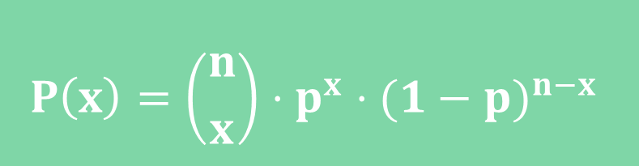
BINOMIAL PROBABILITY FORMULA
$$P\left(x\right)=\left({n \atop x}\right)⋅p^{x}⋅{(1−p)}^{n−x}$$
µ = n · p
$σ^{2}$ = n · p · (1 − p)
σ = $\sqrt{\text{n}\text{ · }\text{p}\text{ · (1 − }\text{p}\text{)}}$
MEAN
VARIANCE
STANDARD DEVIATION
Notes:
And this can be generalised for any number of successes and over any number of trials. So this is the generalised binomial probability formula. If we have a binomial probability distribution, the probability that our random variable will take a value x is n choose x, multiplied by p to the power of x, multiplied by (1-p) to the power of n-x. In other words, the probability of getting exactly x successes in n trials is this thing here. n is the number of trials, x is the number of successes in n trials, and p is the probability of success in any one trial.
We can also define the mean, variance, and standard deviation in simpler terms too. It's easy to see that mean of binomial probability distribution is n times p, because this will give us the mean probability of success across all trials. Variance is n times p times one minus p. Now, we're not going to derive these formulas right now, but you'll have to remember them because we’ll use them quite a lot in the statistics part when testing hypotheses and so on.

